Slide 1

MedFlow AI – An Agentic Cloud-Native Healthcare Intelligence Platform using Microservices, DevOps and DevSecOps
SOA Project Review-1
Date& Time
Thursday, 20th August 2026
 | Under the Guidance of Dr.Neelima Gogineni Associate Professor, Department of Computer Science and Engineering, KLH CSE Bowrampet Campus
Team Members Doma Akshaya – 2420030474 Jithyasri Sammeta - 2420030586 Nallapu Sreeja - 2420030267

Slide 2
Outline of Project Work
Focus
Introduction
Literature Survey
Challenges
Research Objectives
Conclusion & Future Work
References
Publications Details

Slide 3
Problem Statement
Healthcare organizations use multiple systems for patient management, appointments, medical records, laboratories, pharmacy, billing and emergency services. In many existing systems, these functions are tightly coupled or operate as disconnected applications, making information sharing and coordination difficult.
This can lead to:
Fragmented patient information
Inefficient appointment and queue management
Delayed communication between departments
Difficult access to medical and laboratory information
Disconnected pharmacy and billing workflows
Limited personalized nutrition support
Lack of intelligent assistance
Difficulty scaling individual healthcare services

Slide 4
Objectives
Develop a centralized healthcare management platform.
Implement role-based workflows for hospital staff and patients.
Build scalable microservices using Java, Spring Boot, Spring Cloud, and PostgreSQL.
Provide JWT authentication, authorization, and RBAC.
Implement appointments, queues, medical records, lab, pharmacy, billing, notifications, and emergency services.
Integrate Agentic AI using Spring AI and Google Gemini.
Develop AI assistants for patients, doctors, pharmacy, billing, emergency, and hospital operations.
Enable secure AI tool calling with authorized backend services.
Apply DevOps/DevSecOps using GitHub Actions, Docker, Kubernetes, SonarQube, Trivy, and OWASP ZAP.
Implement monitoring and observability using Actuator, Prometheus, and Grafana.
Ensure the platform is secure, scalable, maintainable, and AWS-ready.

Slide 5
Literature Survey
Authors | Title of the Paper | Methodology | Inferences | Limitation/Future work
Dragoni et al. | Microservices: Yesterday, Today, and Tomorrow, 2017 | Microservice architectural principles | Microservices support independent services and modular system design | Does not focus specifically on integrated intelligent healthcare platforms
Silva et al. | A Decoupled Health Software Architecture using Microservices and OpenEHR Archetypes, 2020 | Microservices + OpenEHR | Demonstrates reduced coupling in healthcare software | Focuses mainly on healthcare information architecture rather than AI-assisted workflows
Topol | High-performance medicine: The convergence of human and artificial intelligence, 2019 | AI in healthcare | AI can support clinicians, health systems and patients | Highlights concerns around privacy, bias and transparency
Chen et al. | Personalized Food Recommendation as Constrained Question Answering over a Large-scale Food Knowledge Graph, 2021 | Food knowledge graph + constrained recommendation | Personalized recommendations can consider dietary preferences and health requirements | Focuses on food recommendation rather than integration with hospital services
Ma et al. | Nutrition-Related Knowledge Graph Neural Network for Food Recommendation, 2024 | Knowledge graph + GCN | Combines nutritional information with user preferences for personalized recommendations | Primarily focuses on food recommendation rather than complete healthcare workflows

Slide 6
Problem Gap Identification
Fragmented healthcare systems
Manual coordination
Limited intelligent assistance
Inefficient appointment and queue management
Difficult medical information interpretation
Limited operational intelligence
Weak integration of AI with enterprise systems
Scalability and maintainability challenges
Security and reliability concerns
Need for human-supervised AI

Slide 7
Innovation, Creativity, and Novelty
1. SOA-Based Healthcare Architecture
Healthcare functions are divided into independent services instead of implementing the entire system as one monolithic application.
2. Agentic AI Instead of a Basic Chatbot
The AI does not simply generate text.
It can:
User Request → AI Orchestrator → Agent Selection → Controlled Tool → Healthcare Service → Response
3. Specialized AI Agents
Patient Agent
Doctor Agent
Emergency Agent
Pharmacy Agent
Billing Agent
Hospital Operations Agent
Nutrition & Recovery Agent

Slide 8
4. Nutrition as an Independent Service
Nutrition is not just an AI prompt.
It has its own:
Nutrition profile
Food database
Dietary preferences
Allergy information
Recommendation engine
Meal plans
Recovery plans
Progress tracking
5. AI and Business Logic Separation
The AI cannot directly access databases.
Instead:
AI → Controlled Tool → Service API → Database
This is an important architectural feature.
6. Human Oversight
AI provides decision support, not autonomous diagnosis, treatment, prescription or payment approval.

Slide 9
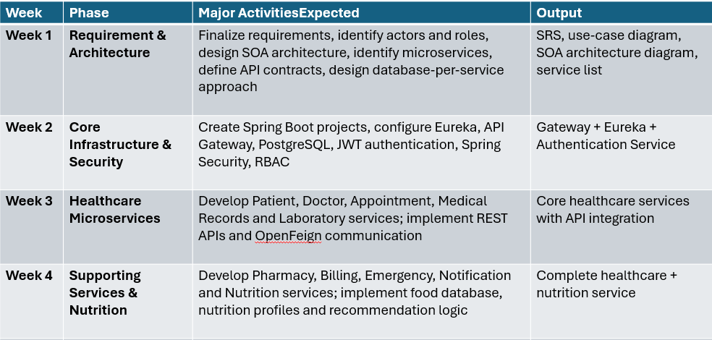
Feasibility and Project Plan

Slide 10
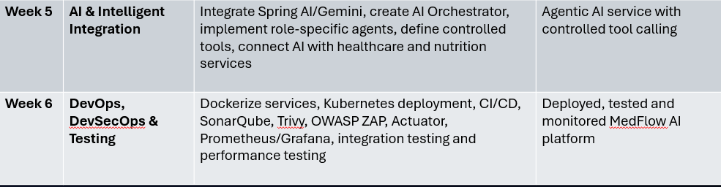
Feasibility and Project Plan

